Slide 1
GCS Mentorship Program:
The Hello Mars Hybrid Cloud Journey
Mentor: Irina Geiman
Mentee: Faisal Iqbal

Slide 2
Iterations
Goal was to create a simple application in a hybrid cloud that contains the best-in-class security features.
Version 1: 2 tier app
Public subnet EC2 instances & Private subnet database deploying using Terraform
Simple Hello World Application
Version 2: 3-tier design
Private subnet EC2 instances and private subnet database
Public subnet bastion host.
Internal users to can remote login into private instances, whether EC2 or DB.
Hybrid Cloud Python Flask Hello Mars Application
Version 3: Site-to-site VPN and authentication via federation for corporate identities
Future

Slide 3
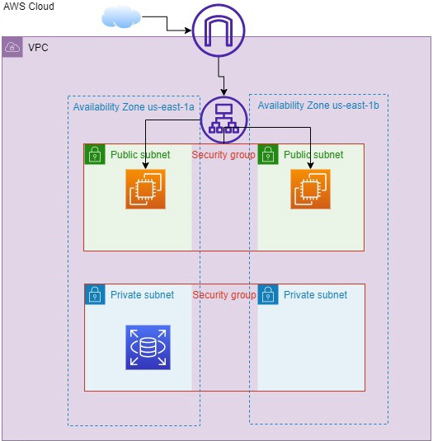
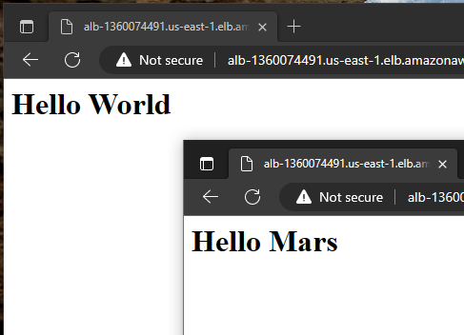
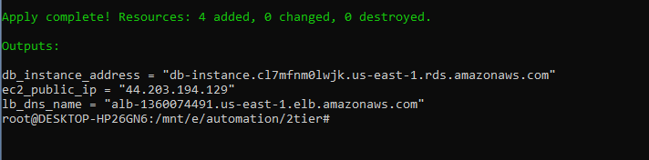
Version 1: 2 tier app
Security Concerns:
Public subnet EC2 instances
No NAT-ing
Use of production EC2 to remote into private subnet DB instance.
Benefits:
Terraform practice
Logical separation of infrastructure

Slide 4
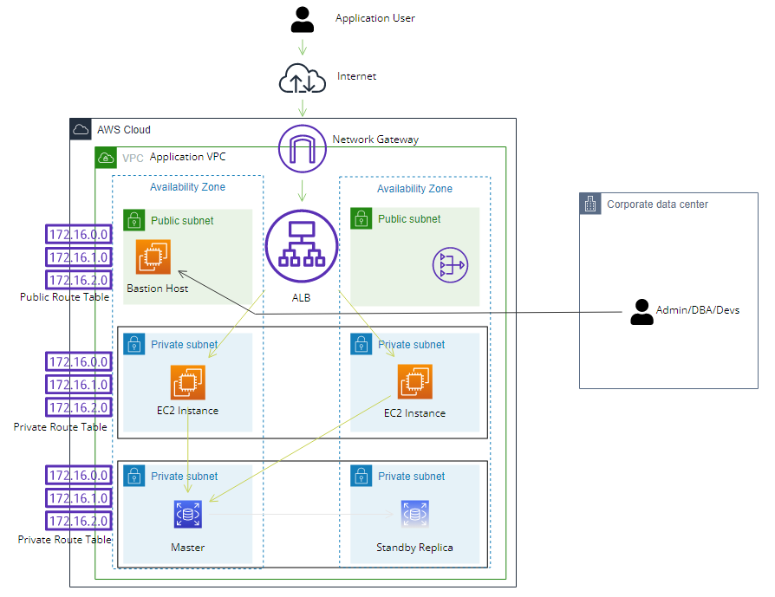
Version 2: 3-tier design
New Security Concerns:
Audit trail
Shared Passwords
Multiple account domains
Notes:
User access EC2 instances in private subnet
3 Security concerns from previous iteration are resolved

Slide 5
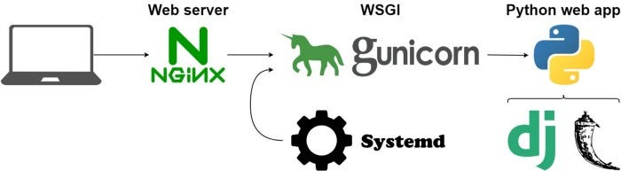
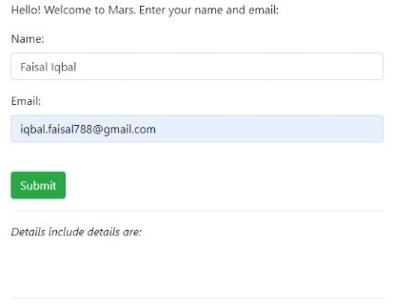
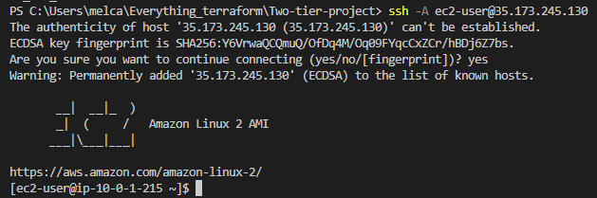
Application Deployment and Database
Application Deployment
Flask is running in dev mode in the terminal
App running in foreground; Ctrl + C bring down the app
Web server (Nginx) and WSGI (Gunicorn)
Demonize the execution to run in the background
Database secrets management
Currently, it is hardcoded into TF files
TFVARS file is an option with gitignore
Best practice to use any of the following:
KeyVault
KMS
Hashicorp Vault
AWS Secrets Manager

Slide 6
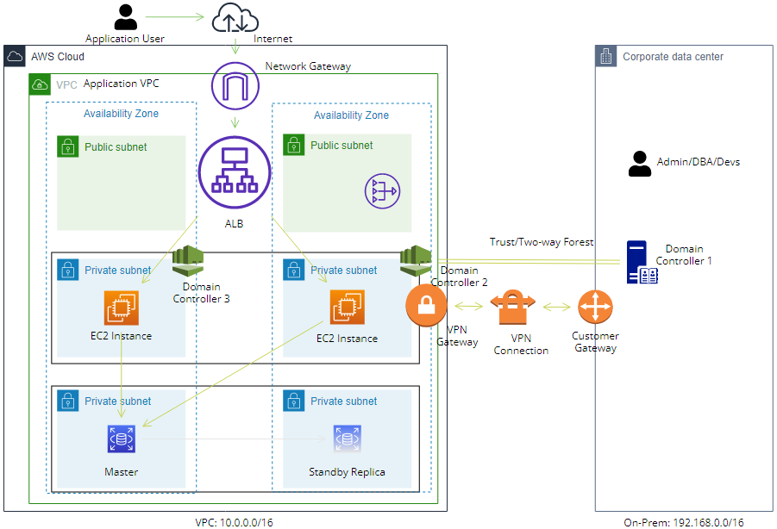
Version 3: Site-to-site VPN and authentication via federation
Notes:
Created this environment in AWS with VPC peering
Created a trust relationship between AWS managed MS AD and another on-prem AD Controller
Server managers allow to federate identities with on-premises AD.

Slide 7
Future Enhancements
More fault-tolerant, more scalable
Multi-OS environment (Linux, Windows)
Availability
Implement standby DB instance
Ability to thwart DDoS attacks

Slide 8
Closing
Terraform code and MOPs are available on GitHub Repo:
iqbal-faisal788/terraform_hello_world (github.com)
Thanks to Irina for encouraging me to think outside the box!!!

